Slide 1
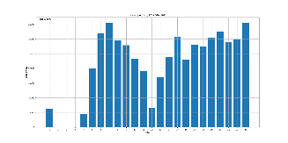
Innovation Hub – Cathrine and Kevin
Findings: On induction + broaching: Created charts that show amount of activity per hour separated into daily charts On induction: Collecting data to cluster maximum energy count per cycle and hope to find patterns On broaching: Making datetime more agnostic (Julian Calendar) makes it easier to compare data without having days/months as guides to predict percentage of tool health. On broaching: Recreating charts to evaluate distance because distance is a new parameter | Needs/requests Induction: Work order logs on tool change or any sort of information/confirmation on when the tool has been changed in the last 4 months General: Retrieve updated logs as they’re completed so we can have more up-to-date information Induction: What is Left/Right Primary Quench
Status/Timing Data cleansing complete for now (using sets of 457 in induction and omitting integer overflow values 32767) Data collation continues On track to have clustered data next week to find patterns | Other

